Slide 1
EMOTION DETECTION MASTER
Anutoshi (1822910011)
Krati Jain (1822910032)
Saima Farheen (1822910061)
Vaibhav Tyagi (1822910075)

Slide 2
INTRODUCTION
Emotions control your thinking, behaviour and actions.
Emotions affect your physical bodies as much as your body affects your feelings and thinking.
Facial expression is a nonverbal scientific gesture which gets expressed in our face as per our emotions.

Slide 3
OBJECTIVE
To provide better services and also better Human-Detection Interaction.
The objective of this project is to develop Automatic Facial Expression Recognition System which can take human facial images containing some expression as input and recognize and classify it into seven different expression class such as:
Neutral , Angry , Disgust , Fear , Happy , Sadness, Surprise .

Slide 4
PROBLEM DEFINITION
Human facial expressions can be easily classified into 7 basic emotions: happy, sad, surprise, fear, anger, disgust, and neutral. Our facial emotions are expressed through activation of specific sets of facial muscles. These sometimes subtle, yet complex, signals in an expression often contain an abundant amount of information about our state of mind. Through facial emotion recognition, we are able to measure the effects that content and services have on the audience/users through an easy and low-cost procedure.

Slide 5
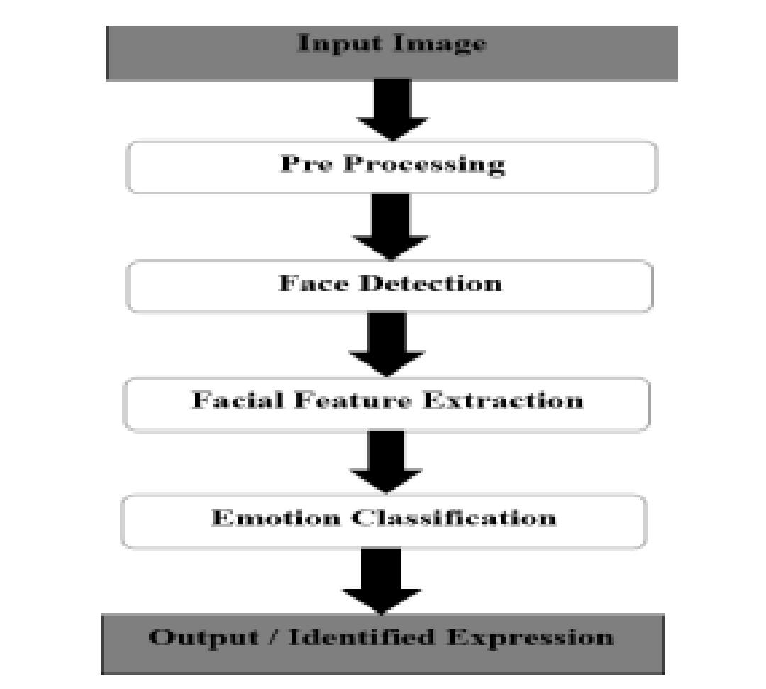
Problem formulation of our project:

Slide 6
FACIAL EXPRESSIONS
Defining expressions in terms of muscle actions A system has been conceived in order to formally categorize the physical expression of emotions.
By studying the contraction or a relaxation of one or more muscles.
The concept of Facial Action Coding System, or FACS created by Paul Ekman and Wallace V. Friesen in 1978.
By identifying different facial cues, scientists are able to map them to their corresponding Action Unit code.
They have proposed the following classification of six basic emotions, according to their Action Units.

Slide 7
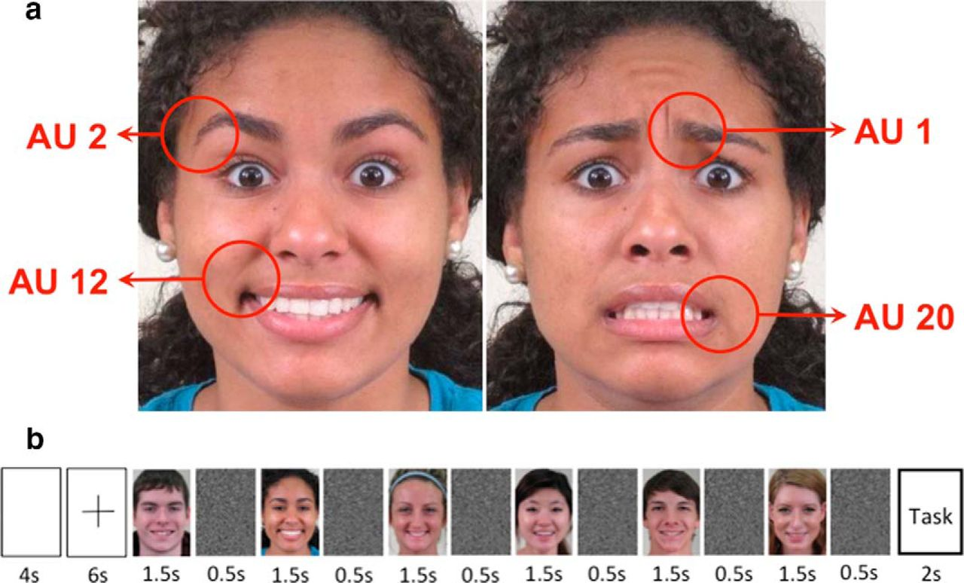
EMOTIONAL EXPERIENCE WITH THEIR UNITS

Slide 8
LITERATURE STUDY OF EMOTIONS
As per various literature surveys it is found that for implementing this project four basic steps are required to be performed.
Pre-processing
Face registration
Facial feature extraction
Emotion classification

Slide 9
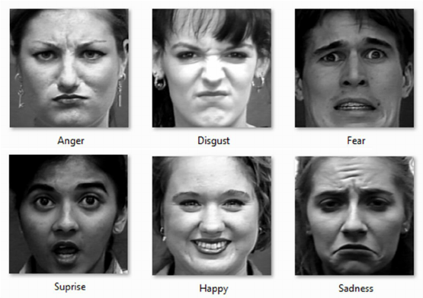

Slide 10
CONCLUSION
The facial expression recognition system presented in this research work contributes a resilient face recognition model based on the mapping of behavioral characteristics with the physiological biometric characteristics.
The physiological characteristics of the human face with relevance to various expressions such as happiness, sadness, fear, anger, surprise and disgust are associated with geometrical structures which restored as base matching template for the recognition system.

Slide 11
REFERENCES
A literature survey on Facial Expression Recognition using Global Featuresby Vaibhavkumar J. Mistry and Mahesh M. Goyani,International Journal of Engineering and Advanced Technology (IJEAT),April,2013 [http://citeseerx.ist.psu.edu/viewdoc/download?doi=10.1.1.645.5162 HYPERLINK "http://citeseerx.ist.psu.edu/viewdoc/download?doi=10.1.1.645.5162&rep=rep1&typ" HYPERLINK "http://citeseerx.ist.psu.edu/viewdoc/download?doi=10.1.1.645.5162 HYPERLINK "http://citeseerx.ist.psu.edu/viewdoc/download?doi=10.1.1.645.5162&rep=rep1&typ"& HYPERLINK
Recognizing Facial Expressions Using Deep Learning by Alexandru Savoiu Stanford University and James Wong Stanford University [http://cs231n.stanford.edu/reports/2017/pdfs/224.pdf

Slide 12
THANK YOU

